Slide 1
Fast Coupled Sequence Labeling on Heterogeneous Annotations via Context-aware Pruning
Zhenghua Li, Jiayuan Chao, Min Zhang, Jiwen Yang
{zhli13, minzhang, jwyang}@suda.edu.cn; china_cjy@163.com;
Soochow University, China

Slide 2
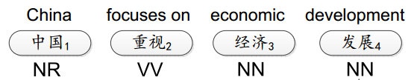
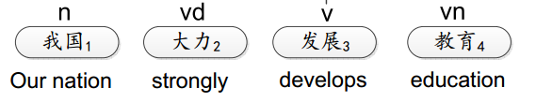
An interesting problem in our mind – POS tagging
CTB
How to effectively learn from heterogeneous data?
PD
Notes:
Here we give an example.
In the above is a sentence from Penn Chinese treebank, which is widely used in research lexical and syntactic analysis
while in the below is a sentence from People Daily, which provide word boundaries and pos tags.
The two data are annotated in different time, by different organizations, and follows different guidelines.
Then the question is how to train a better model with such data so that both sides can benefit.
CTB is annotated in Pennsylvania University, leaded by Xia, Xue, and colleagues while
PD is annotated in Peking University, leaded by Shiwen Yu.

Slide 3
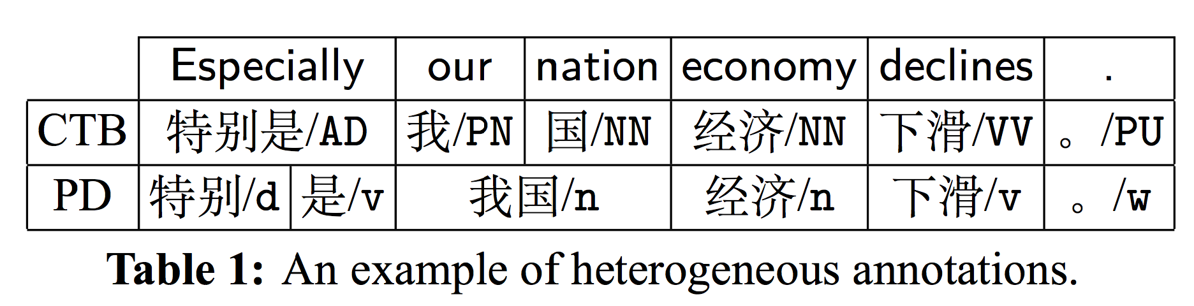
An interesting problem in our mind – joint WS&POS tagging
How to effectively train statistical models with heterogeneous data?
Notes:
Here we give an example.
In the above is a sentence from Penn Chinese treebank, which is widely used in research lexical and syntactic analysis
while in the below is a sentence from People Daily, which provide word boundaries and pos tags.
The two data are annotated in different time, by different organizations, and follows different guidelines.
Then the question is how to train a better model with such data so that both sides can benefit.
CTB is annotated in Pennsylvania University, leaded by Xia, Xue, and colleagues while
PD is annotated in Peking University, leaded by Shiwen Yu.

Slide 4
Challenges
How to capture the structure/tag correspondences between two guidelines?
  Usually context-sensitive.
The datasets (CTB/PD) are typically non-overlapping. Thus it is difficult to build a model to automatically learn the correspondences.
Notes:
For this idea, we have two key challenges.
The first one is how to …?
It should be pointed out that such correspondences are mostly context dependent and very hard to represent with rules.
The second challenge is that the two datasets are non-overlapping.
In other words, all sentences have only one-side annotations.
Therefore, we cannot directly build a model to automatically learn the correspondences.

Slide 5
Previous work
Guide-feature based method (indirectly use one data to produce automatic guide labels on another data)
  Word segmentation, POS tagging (Jiang+ 09; Sun & Wan 12; Jiang+12; Gao+ 14)
  Dependency parsing (Li+ 12)
  Constituent treebank conversion (Zhu+ 11; Jiang+ 13)
  …
Notes:
Actually, this issue of utilizing multiple heterogeneous data has attracted lots of research attention during the past few years.
The most typical method is the guide-feature based method, which very similar to the idea of stacked learning.
The guide-feature based method has been successfully applied to a variety of tasks, including word segmentation, …

Slide 6
Previous work
Coupled sequence labeling: directly learn from heterogeneous data
  Joint word segmentation and POS tagging (Qiu+ 13)
  POS tagging (Li+ 15, Chen+ 16)
Notes:
Actually, this issue of utilizing multiple heterogeneous data has attracted lots of research attention during the past few years.
The most typical method is the guide-feature based method, which very similar to the idea of stacked learning.
The guide-feature based method has been successfully applied to a variety of tasks, including word segmentation, …

Slide 7
Two drawbacks of the coupled approach of Li+ 15
Manually design tag-to-tag mapping rules to constrain the search space
  Very difficult for POS tagging
  Impossible for joint WS&POS tagging
  Hurt accuracy
Still very inefficient
This work solves the efficiency problem, making the coupled approach more elegant and general.
Notes:
Actually, this issue of utilizing multiple heterogeneous data has attracted lots of research attention during the past few years.
The most typical method is the guide-feature based method, which very similar to the idea of stacked learning.
The guide-feature based method has been successfully applied to a variety of tasks, including word segmentation, …

Slide 8
The big picture
Converting CTB+PD into
the same bundled tag space
NR_n
(ambiguous labeling)
CTB
中国/NR
PD
中国/n
Coupled Tagger (CTB+PD)
Test sentence:
中国 加油
Output:
中国/NR_n 加油/VV_v
Notes:
Then, we show a big picture of this work.
First, we transform each data so that
The two dataset are in the same bundled tag space, and both are ambiguously labeled.
Then, we merge the two datasets, and train a coupled model.
For a test sentence, our coupled model directly assign both-side tags to each word in the form of bundled tags.
As mentioned earlier, our approach has two challenges.
The first one is how to created bundled tags, the other one is how to train the model with ambiguous labeling.

Slide 9
Step 1:
Convert CTB+PD into
the same bundled tag space
NR_n
(ambiguous labeling)
Notes:
First we show how to solve the first challenge.

Slide 10
A CTB sentence as an example
Bundled Tags
PD: 38 tags
[NR, ad]
[NR, n]
[NR, ns]
[NR, nt]
[NR, nz]
[NR, nx]
[NR, nr]
[NR, …]
[VV, ad]
[VV, n]
[VV, ns]
[VV, nt]
[VV, nz]
… ….
 | CTB:32 tags
中国 | NR
重视 | VV
经济 | NN
发展 | NN
ad
n
ns
nt
nz
nx
nr
…
[NR, ad]
[NR, n]
[NR, ns]
[NR, nt]
[NR, nz]
[NR, nx]
[NR, nr]
[NR, …]
38
32*38
Possibly-correct tag set
The whole tag set
10
10
Notes:
First we show how to solve the first challenge.

Slide 11
Ambiguous labeling (a CTB sentence)
中国 | 重视 | 经济 | 发展
NR | VV | NN | NN
Possibly-correct paths:
中国 | 重视 | 经济 | 发展
NR_ad NR_n NR_ns NR_nt NR_nz … | VV_ad VV_n VV_ns VV_nt VV_Nz … | NN_ad NN_n NN_ns NN_nt NN_nz … | NN_ad NN_n NN_ns NN_nt NN_nz …
Ambiguous labeling is a set of paths (exponential)
Notes:
Again, this is the example of ambiguous labeling, the problem is how to effectively train our CRF model with such data.
Training with ambiguous labeling is a situation between supervised training and unsupervised training.
When the label set includes all POS sequences, then it becomes unsupervised training.
In contrast, when the set include only one sequence, it becomes traditional supervised learning.

Slide 12
Ambiguous labeling (a PD sentence)
我国 | 大力 | 发展 | 教育
n | ad | v | vn
Possibly-correct paths:
中国 | 重视 | 经济 | 发展
AD_n AS_n BA_n NN_n NR_n … | AD_ad AS_ad BA_ad NN_ad NR_ad … | AD_v AS_v BA_v NN_v NR_v … | AD_vn AS_vn BA_vn NN_vn NR_vn …
Ambiguous labeling is a set of paths (exponential)
Notes:
Again, this is the example of ambiguous labeling, the problem is how to effectively train our CRF model with such data.
Training with ambiguous labeling is a situation between supervised training and unsupervised training.
When the label set includes all POS sequences, then it becomes unsupervised training.
In contrast, when the set include only one sequence, it becomes traditional supervised learning.

Slide 13
Step 2:
Train the coupled model on
CTB+PD
with ambiguous labeling
Notes:
First we show how to solve the first challenge.

Slide 14
Learning, supervision
Unsupervised
中国 | 重视 | 经济 | 发展
？ | ? | ? | ？
Supervised
中国 | 重视 | 经济 | 发展
NR | VV | NN | NN
In the middle
中国 | 重视 | 经济 | 发展
NR | VV | NN | NN VV
Notes:
Again, this is the example of ambiguous labeling, the problem is how to effectively train our CRF model with such data.
Training with ambiguous labeling is a situation between supervised training and unsupervised training.
When the label set includes all POS sequences, then it becomes unsupervised training.
In contrast, when the set include only one sequence, it becomes traditional supervised learning.

Slide 15
Ambiguous labeling (partial annotation, natural annotation)
Relaxed/weak supervision
  Multilingual transfer on dependency parsing (Tackstrom+ 13)
  Semi-supervised dependency parsing (Li+ 14)
  Active learning with partial annotation (Li + 12, Li + 16)
  Word segmentation (Jiang+ 13; Liu+14; Yang and Vozila 14)
Notes:
Therefore, training with ambiguous labeling can be understood as relaxed or weak supervision.
Actually, in the past two years,
Lots of work has been done on this issue for a variety of tasks.

Slide 16
Train with ambiguous labeling
Maximize the likelihood of the data
Maximize the probability of a set of paths
Maximize the sum probability of all paths in the set
Gradient:
feature expectation over all possibly-correct paths
- feature expectation over the whole tag space
Can be solved with the forward-backward algorithm
Notes:
We will skip the detailed equations. Please refer to our paper. I will also release a short technical report which include all detailed derivations in my homepage.
The basic idea is to maximize the likelihood of the data.
It can be understood as to maximize
Finally, after several steps of derivation, we can efficiently compute the gradient of the likelihood using the forward-backward algorithm.

Slide 17
The efficiency problem:
Forward-backward algorithm:
O(n|T|²)
T=1000 for POS tagging
T=10000 for joint WS&POS tagging
Notes:
First we show how to solve the first challenge.

Slide 18
A CTB sentence as an example
Bundled Tags
PD: 38 tags
[NR, ad]
[NR, n]
[NR, ns]
[NR, nt]
[NR, nz]
[NR, nx]
[NR, nr]
[NR, …]
[VV, ad]
[VV, n]
[VV, ns]
[VV, nt]
[VV, nz]
… ….
 | CTB:32 tags
中国 | NR
重视 | VV
经济 | NN
发展 | NN
ad
n
ns
nt
nz
nx
nr
…
[NR, ad]
[NR, n]
[NR, ns]
[NR, nt]
[NR, nz]
[NR, nx]
[NR, nr]
[NR, …]
38
32*38
Possibly-correct tag set
The whole tag set
18
18
Notes:
First we show how to solve the first challenge.

Slide 19
A CTB sentence as an example
Bundled Tags
PD: 128 tags
 | CTB: 99 tags
特 | B@AD
别 | I@AD
是 | E@AD
我 | S@PN
…
B@ad
I@ad
E@ad
S@ad
B@n
I@n
E@n
…
[B@AD, B@ad]
[B@AD, I@ad]
[B@AD, E@ad]
[B@AD, S@ad]
[B@AD, B@n]
…
[I@AD, B@ad]
[I@AD, I@ad]
[I@AD, E@ad]
[I@AD, S@ad]
[I@AD, B@n]
…
[B@AD, B@ad]
[B@AD, I@ad]
[B@AD, E@ad]
[B@AD, S@ad]
[B@AD, B@n]
[B@AD, I@n]
[B@AD, E@n]
…
128
99*128
Possibly-correct tag set
The whole tag set
19
19
Notes:
First we show how to solve the first challenge.

Slide 20
Let’s solve the efficiency problem
Notes:
First we show how to solve the first challenge.

Slide 21
Tag-wise mapping rules
(Qiu+ 13, Li+ 15)
Manually define a set of symmetric mapping rules
  NN => n vn Ng …
  NR => nr ns nt nz …
  VV => v a Vg i …
  …
|T|=32*38=1,054 => 179 for POS tagging
|T| = 99*128=12,672=>? for WS&POS
Notes:
We borrow the idea of Qiu+ 2013, and use a mapping function to create bundled tags.
A mapping function is a manually designed set of rules which tell us which CTB tag can be mapped to which PD tag.
For example, this rule tells us that a CTB tag NN can be mapped into a set of PD tags, including n, vn, Ng, etc.
Please note that such mapping rules are symmetric.

Slide 22
Tag-wise mapping rules
(Qiu+ 13, Li+ 15)
  NR => nr ns nt nz
Bundled Tags
PD: 38 tags
[NR, ad]
[NR, n]
[NR, ns]
[NR, nt]
[NR, nz]
[NR, nx]
[NR, nr]
[NR, …]
[VV, ad]
[VV, n]
[VV, ns]
[VV, nt]
[VV, nz]
… ….
 | CTB:32 tags
中国 | NR
重视 | VV
经济 | NN
发展 | NN
ad
n
ns
nt
nz
nx
nr
…
[NR, ad]
[NR, n]
[NR, ns]
[NR, nt]
[NR, nz]
[NR, nx]
[NR, nr]
[NR, …]
4
179
Possibly-correct tag set
The whole tag set
22
22
Notes:
We borrow the idea of Qiu+ 2013, and use a mapping function to create bundled tags.
A mapping function is a manually designed set of rules which tell us which CTB tag can be mapped to which PD tag.
For example, this rule tells us that a CTB tag NN can be mapped into a set of PD tags, including n, vn, Ng, etc.
Please note that such mapping rules are symmetric.

Slide 23
Mapping rules should be:
tag-wise => context-aware
 | CTB:32 tags
中国 | NR
重视 | VV
经济 | NN
发展 | NN
ad
n
ns
nt
nz
nx
nr
…
Notes:
First we show how to solve the first challenge.

Slide 24
Context-aware pruning
(r=2, lambda=1.0)
中国 重视 经济 发展
CTB 32 Tags
PD 38 Tags
NR | 0.8
NN | 0.1
VV | 0.06
AD | 0.02
VA | 0.01
SP | 0.005
P | 0.001
… | …
ns | 0.9
nt | 0.05
n | 0.03
nz | 0.01
nr | 0.003
nx | 0.002
ad | 0.001
… | …
NR
NN
nr
n
Bundled Tags
24
Notes:
First we show how to solve the first challenge.

Slide 25
Context-aware pruning
 | CTB:32 tags
中国 | NR
重视 | VV
经济 | NN
发展 | NN
[NR, ns]
[NR, nt]
[NN, ns]
[NN, nt]
[NR, nr]
[NR, n]
r=2
r²=4
Possibly-correct tag set
The whole tag set
Forward-backward: O(n|T|²) => O(nr⁴)
25
25
Notes:
First we show how to solve the first challenge.

Slide 26
How to perform context-aware pruning?
Online vs. offline
Notes:
First we show how to solve the first challenge.

Slide 27
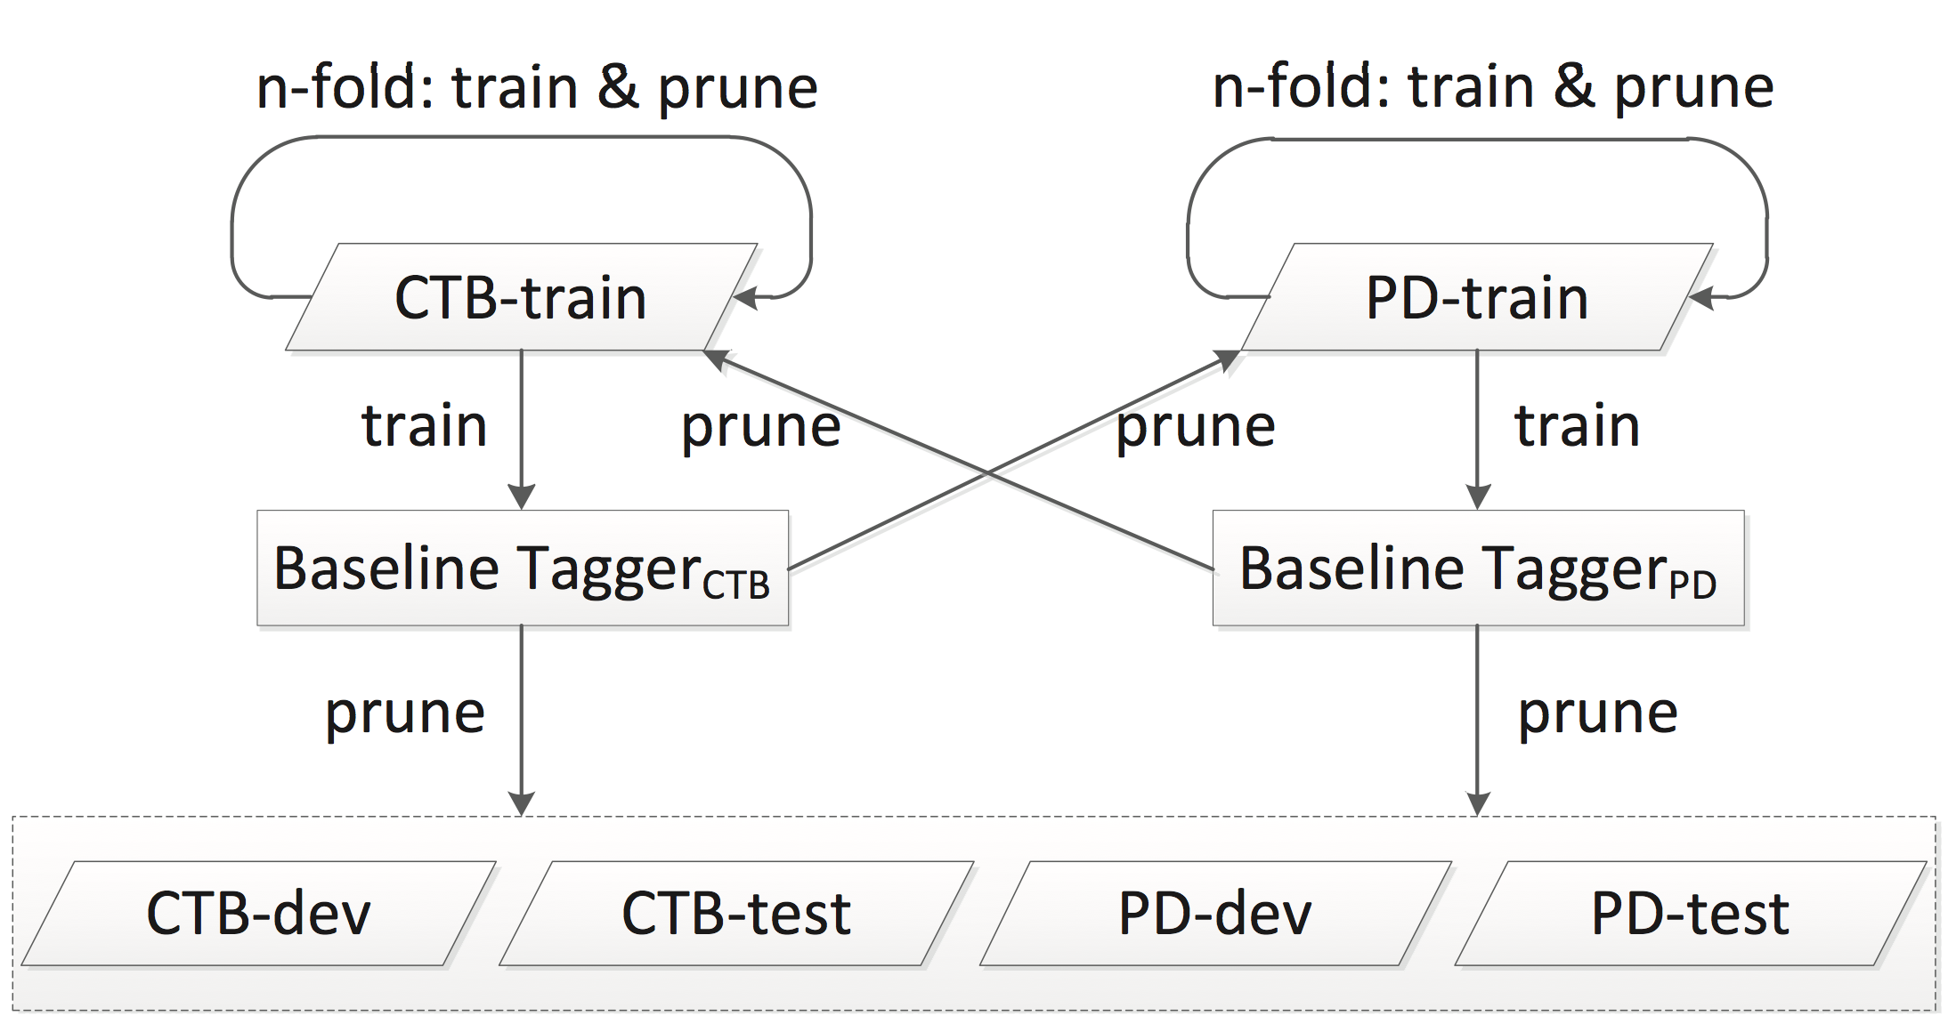
Offline context-aware pruning
Notes:
We borrow the idea of Qiu+ 2013, and use a mapping function to create bundled tags.
A mapping function is a manually designed set of rules which tell us which CTB tag can be mapped to which PD tag.
For example, this rule tells us that a CTB tag NN can be mapped into a set of PD tags, including n, vn, Ng, etc.
Please note that such mapping rules are symmetric.

Slide 28
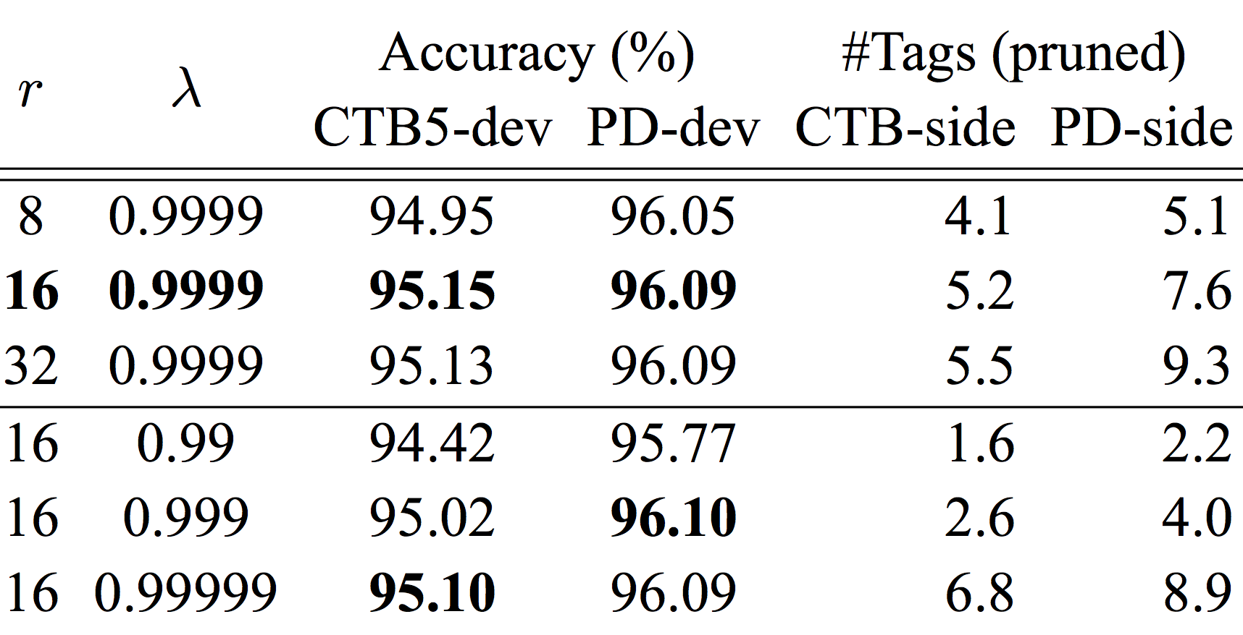
Results – POS tagging
Notes:
First, we compare the performance of the coupled model on CTB-dev data with different mapping functions.
Here is the baseline model, which is trained on only CTB data.
Surprisingly, we find that the coupled model perform very bad using the tight mapping function.
As the mapping function becomes more relaxed, the coupled model achieves better performance.
In fact, when we use the complete mapping function, which means a CTB tag are mapped into all PD tags, vice versa.
The coupled model achieve best performance.
This indicates that our coupled model can learn the implicit mapping between annotation, without the need of linguistic constraints.
However, the coupled model gets extremely slow for both training and decoding when the tag set becomes larger.
Therefore, in the following experiments, we adopt the relaxed mapping function.

Slide 29
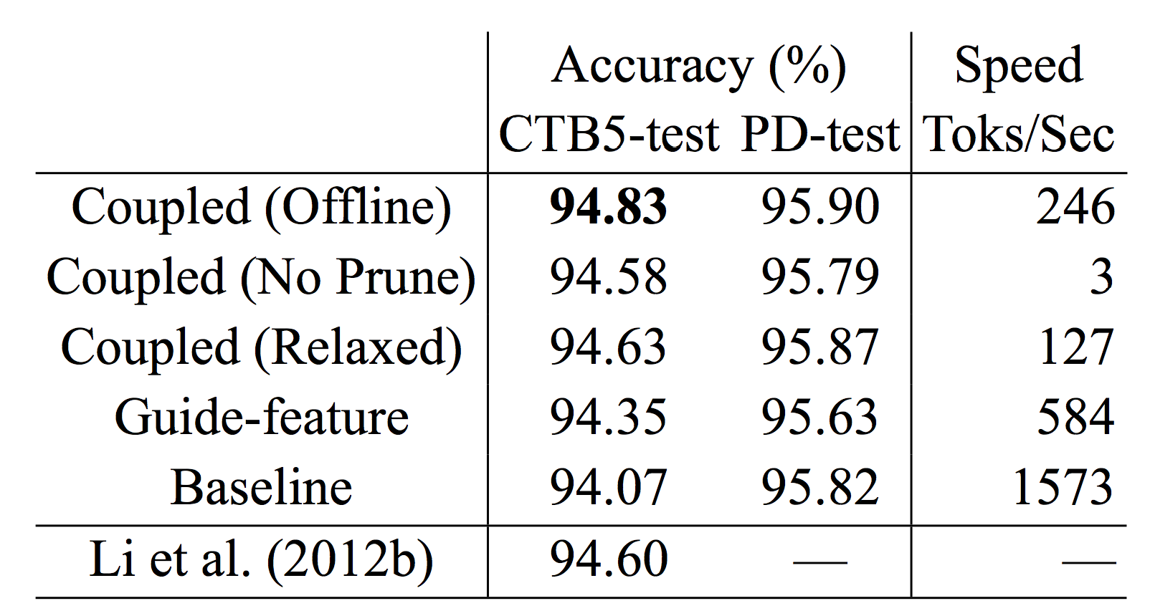
Results – POS tagging
Notes:
First, we compare the performance of the coupled model on CTB-dev data with different mapping functions.
Here is the baseline model, which is trained on only CTB data.
Surprisingly, we find that the coupled model perform very bad using the tight mapping function.
As the mapping function becomes more relaxed, the coupled model achieves better performance.
In fact, when we use the complete mapping function, which means a CTB tag are mapped into all PD tags, vice versa.
The coupled model achieve best performance.
This indicates that our coupled model can learn the implicit mapping between annotation, without the need of linguistic constraints.
However, the coupled model gets extremely slow for both training and decoding when the tag set becomes larger.
Therefore, in the following experiments, we adopt the relaxed mapping function.

Slide 30
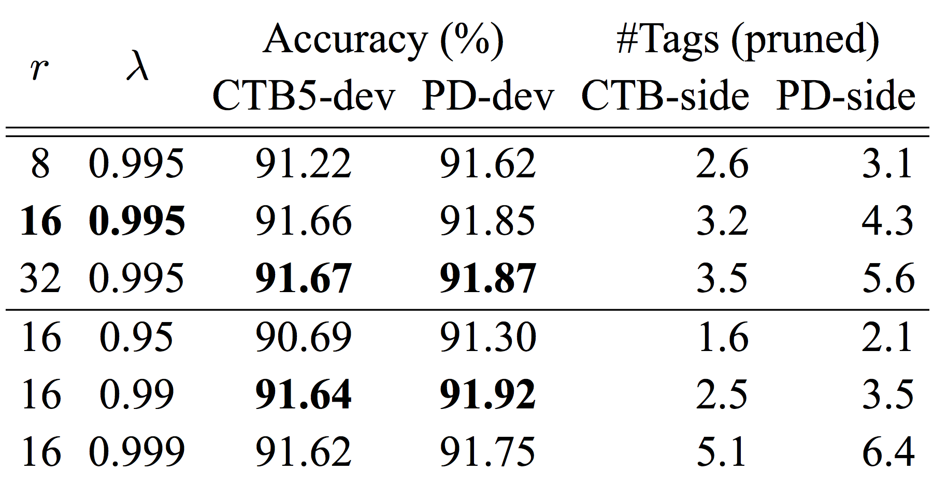
Results – joint WS&POS tagging
Notes:
First, we compare the performance of the coupled model on CTB-dev data with different mapping functions.
Here is the baseline model, which is trained on only CTB data.
Surprisingly, we find that the coupled model perform very bad using the tight mapping function.
As the mapping function becomes more relaxed, the coupled model achieves better performance.
In fact, when we use the complete mapping function, which means a CTB tag are mapped into all PD tags, vice versa.
The coupled model achieve best performance.
This indicates that our coupled model can learn the implicit mapping between annotation, without the need of linguistic constraints.
However, the coupled model gets extremely slow for both training and decoding when the tag set becomes larger.
Therefore, in the following experiments, we adopt the relaxed mapping function.

Slide 31
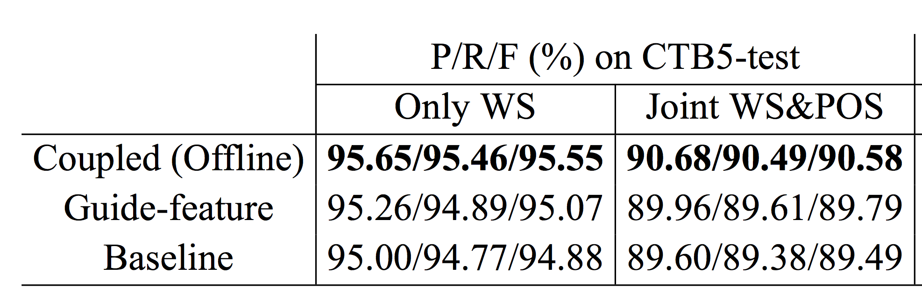
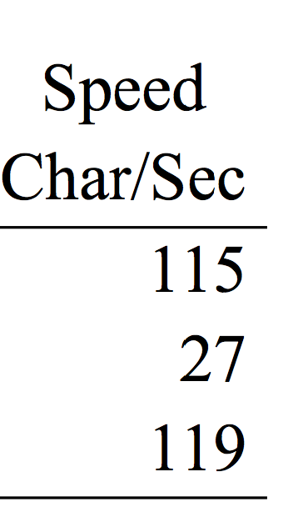
Results – joint WS&POS tagging
Notes:
First, we compare the performance of the coupled model on CTB-dev data with different mapping functions.
Here is the baseline model, which is trained on only CTB data.
Surprisingly, we find that the coupled model perform very bad using the tight mapping function.
As the mapping function becomes more relaxed, the coupled model achieves better performance.
In fact, when we use the complete mapping function, which means a CTB tag are mapped into all PD tags, vice versa.
The coupled model achieve best performance.
This indicates that our coupled model can learn the implicit mapping between annotation, without the need of linguistic constraints.
However, the coupled model gets extremely slow for both training and decoding when the tag set becomes larger.
Therefore, in the following experiments, we adopt the relaxed mapping function.

Slide 32
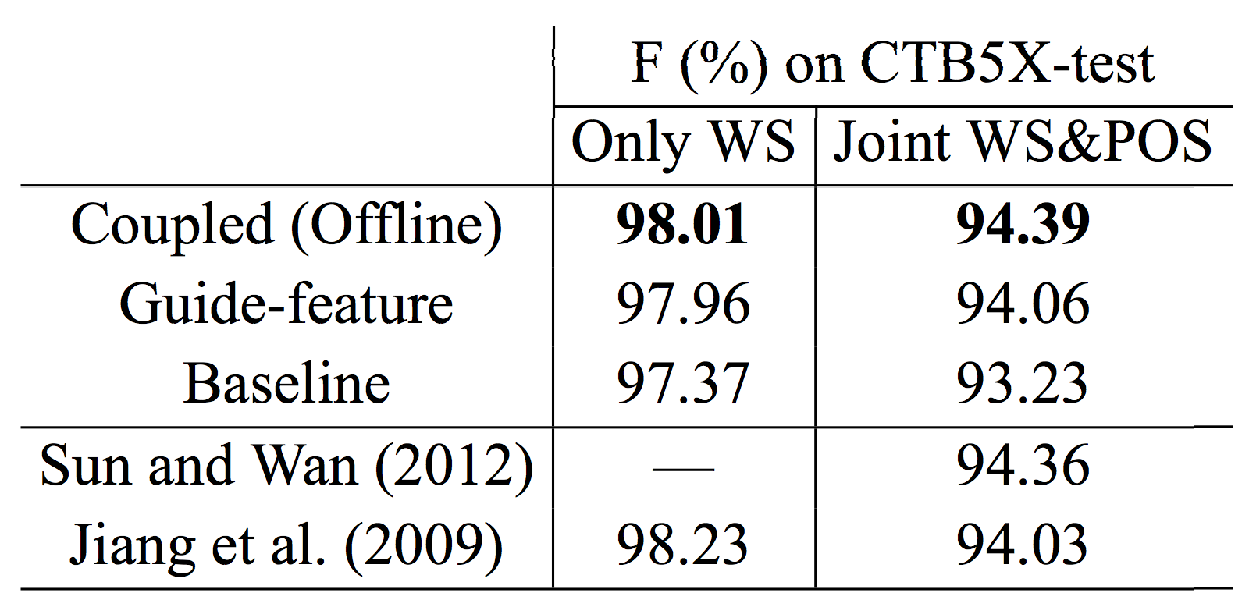
Results – joint WS&POS tagging
Notes:
First, we compare the performance of the coupled model on CTB-dev data with different mapping functions.
Here is the baseline model, which is trained on only CTB data.
Surprisingly, we find that the coupled model perform very bad using the tight mapping function.
As the mapping function becomes more relaxed, the coupled model achieves better performance.
In fact, when we use the complete mapping function, which means a CTB tag are mapped into all PD tags, vice versa.
The coupled model achieve best performance.
This indicates that our coupled model can learn the implicit mapping between annotation, without the need of linguistic constraints.
However, the coupled model gets extremely slow for both training and decoding when the tag set becomes larger.
Therefore, in the following experiments, we adopt the relaxed mapping function.

Slide 33
Results – joint WS&POS tagging
Improvements over most word/POSs
CTB5-test: 卢森博格/NR (11次)
PD-train:卢森堡/NR 克拉泽博格/NR
Notes:
First, we compare the performance of the coupled model on CTB-dev data with different mapping functions.
Here is the baseline model, which is trained on only CTB data.
Surprisingly, we find that the coupled model perform very bad using the tight mapping function.
As the mapping function becomes more relaxed, the coupled model achieves better performance.
In fact, when we use the complete mapping function, which means a CTB tag are mapped into all PD tags, vice versa.
The coupled model achieve best performance.
This indicates that our coupled model can learn the implicit mapping between annotation, without the need of linguistic constraints.
However, the coupled model gets extremely slow for both training and decoding when the tag set becomes larger.
Therefore, in the following experiments, we adopt the relaxed mapping function.

Slide 34
Conclusions
Propose context-aware pruning for coupled sequence labeling
  Solve the efficiency
  No need for manual mapping rules
  The coupled approach is more generally applicable.
Empirical comparison of online vs. offline pruning, leading to very interesting findings

Slide 35
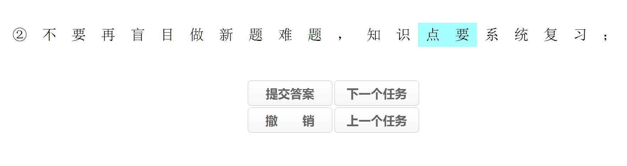
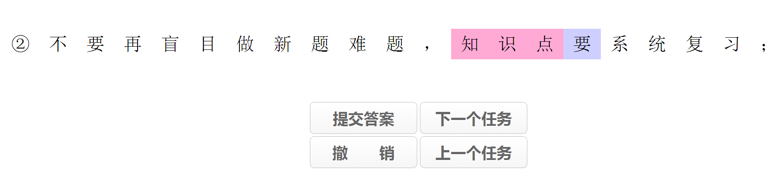
Future directions
  Annotation conversion
  Multi-granularity word segmentation

Slide 36
Acknowledgement
  Meishan Zhang
  Wenliang Chen
  My students: Wei Chen, Ziwei Fan, Yue Zhang, …

Slide 37
Thanks for your time!
Questions?
Codes and all experimental settings are released at
http://hlt.suda.edu.cn/~zhli

Slide 38
The coupled model
Notes:
Before we turn to the second challenge, we need to describe our coupled model.

Slide 39
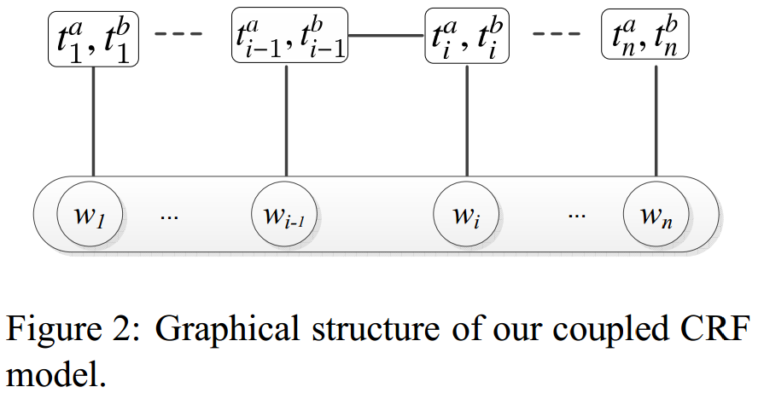
The coupled CRF model
Notes:
Here is the graphical structure of our coupled model, which is actually a small extension to the classic conditional random field model.
The only difference is that each word has a pair of tags, instead of a single tag.
We can see that our coupled model does not change the structure of the classic CRF model.
Therefore, we do not need to design new or complex algorithms.
This is the conditional probability of a tag sequence t, given a sentence x.
This is the score of a tag sequence.
This is the normalization term.

Slide 40
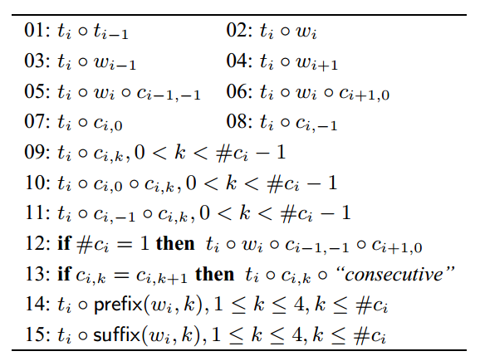
Features in baseline/coupled model
Notes:
Here, we show the feature templates we used in our baseline/coupled model.

Slide 41
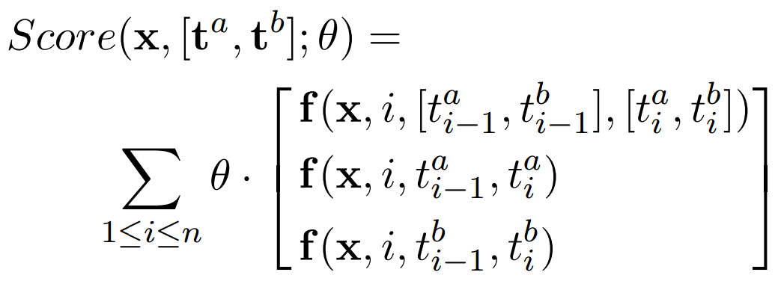
Features in the coupled model
Joint features
Separate features
Notes:
Different from the baseline model, the coupled model has a much richer feature representation, which consists of three terms.
The first term can be called the joint features, which considers coupled tags at the same time.
The next two terms can be called the separate features, which considers one-side tags at a time.

Slide 42

Features in the coupled model
外交部₁ Foreign Ministry | 发言人₂ Spokesman | 答₃ answers
 | NN_n
 | NN_n^外交部 NN^外交部 n^外交部
Joint features
Separate features
Notes:
Here we give an example, suppose we want to tag the second word with a bundled tag NN_n.
The number 03 feature template concatenates the current tag with the previous word.
Then the feature template is instantiated into three concrete features.
Please note that in the traditional model, a CTB tagger only uses this feature while a PD tagger only uses this feature.

Slide 43
Advantages of our coupled model?
Both datasets are directly used for training.
Can use both joint and separate features.
  Joint features capture the implicit correspondences between annotations.
  Separate features function as back-off/base features.
Notes:
Compared with a traditional CRF model, our coupled model has two advantages.
Since the joint features may suffer from data sparseness problem.

Slide 44
Previous work (Qiu+ 13)
We are directly inspired by their work.
Differences from our work
  Joint word segmentation and POS tagging
  Linear model with perceptron-like training
  Only explore separate features
  Approximate decoding
  Rely on manually designed mapping functions
Notes:
Finally, we want to introduce the mostly related work of Qiu+ 2013.
This work is directly inspired by their work, with a few important differences.
First,

Slide 45
Guide-feature based method
PD
中国/n
Tagger (PD)
CTB
中国/NR (n)
Tagger (CTB)
Extra guide features
Notes:
The basic idea of the guide-feature based method is to use the source data to produce guide features on the target data.
Here we suppose PD is the source data, and CTB is the target data.
First, we use PD to train a source tagger, called tagger PD
Then, we use tagger PD to parse the whole set of CTB, including all training/dev/test data.
Therefore, for sentences in CTB, each word has two different tags.
One is the gold-standard CTB tag, and the other is the noisy, error-prone PD tag.
Then, we try to train a target tagger, called tagger CTB.
Different from the traditional method introduced in the previous slide, Tagger CTB now can use the noisy PD tags as extra guide features.
In other words, the target parser constantly consults the source parser before making its own decision.

Slide 46
The problem with guide-feature based method
The methodology is not elegant: twice training/decoding
The source data does not directly contribute to the training of the target tagger, and thus seems not fully exploited. The final target model does not directly learn from the source sentences.
Notes:
However, we believe that the guide-feature based method has two major drawbacks.
The first is that, …
The second problem is that the ..

