Slide 1
Coupled Sequence Labeling on Heterogeneous Annotations (POS tagging)
Zhenghua Li, Jiayuan Chao, Min Zhang, Wenliang Chen
{zhli13, minzhang, wlchen}@suda.edu.cn; china_cjy@163.com;
Soochow University, China
Notes:
Good afternoon, everyone.
I am Zhenghua Li.
We come from Soochow University, China.

Slide 2
An interesting problem in our mind
The existence of multiple labeled data, with different annotation guidelines or formulations (heterogeneous annotations)
How to effectively utilize such data?
How to train a model with heterogeneous data?
Notes:
This is the big picture
Belongs to semi-supervised parsing
The idea is to get more high-quality labeled data for Chinese from bilingual texts by projecting English parse trees into Chinese,
And then combine the manually labeled data with the automatically collected data to train new parsing models,
In order to improve state-of-the-art Chinese dependency parsers.

Slide 3
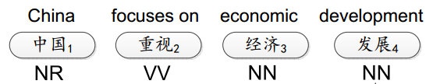
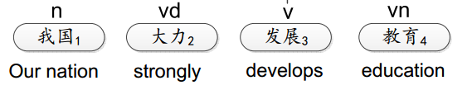
An interesting problem in our mind
CTB
Train a better model?
PD
Notes:
This is the big picture
Belongs to semi-supervised parsing
The idea is to get more high-quality labeled data for Chinese from bilingual texts by projecting English parse trees into Chinese,
And then combine the manually labeled data with the automatically collected data to train new parsing models,
In order to improve state-of-the-art Chinese dependency parsers.

Slide 4
Challenges
How to capture the structure/tag correspondences between two guidelines?
  Usually context-dependent. Hard to represent with rules.
The datasets (PD/CTB) are typically non-overlapping. Thus it is difficult to build a model to automatically learn the correspondences.
Notes:
This is the big picture
Belongs to semi-supervised parsing
The idea is to get more high-quality labeled data for Chinese from bilingual texts by projecting English parse trees into Chinese,
And then combine the manually labeled data with the automatically collected data to train new parsing models,
In order to improve state-of-the-art Chinese dependency parsers.

Slide 5
Previous work
Guide-feature based methods (stacked learning)
  Word segmentation, POS tagging (Jiang+ 09; Sun & Wan 12; Jiang+12; Gao+ 14)
  Dependency parsing (Li+ 12)
  Constituent treebank conversion (Zhu+ 11; Jiang+ 13)
  …
Notes:
This is the big picture
Belongs to semi-supervised parsing
The idea is to get more high-quality labeled data for Chinese from bilingual texts by projecting English parse trees into Chinese,
And then combine the manually labeled data with the automatically collected data to train new parsing models,
In order to improve state-of-the-art Chinese dependency parsers.

Slide 6
Guide-feature based methods
PD
中国/n
Tagger (PD)
CTB
中国/NR
Tagger (CTB)
Notes:
This is the big picture
Belongs to semi-supervised parsing
The idea is to get more high-quality labeled data for Chinese from bilingual texts by projecting English parse trees into Chinese,
And then combine the manually labeled data with the automatically collected data to train new parsing models,
In order to improve state-of-the-art Chinese dependency parsers.

Slide 7
Guide-feature based methods
PD
中国/n
Tagger (PD)
CTB
中国/NR (n)
Tagger (CTB)
Extra guide features
Notes:
This is the big picture
Belongs to semi-supervised parsing
The idea is to get more high-quality labeled data for Chinese from bilingual texts by projecting English parse trees into Chinese,
And then combine the manually labeled data with the automatically collected data to train new parsing models,
In order to improve state-of-the-art Chinese dependency parsers.

Slide 8
The problem with guide-feature based methods
The methodology is not simple/elegant: twice training/decoding. Although
  very effective and robust for different problems
  very simple to implement.
The source data is not fully exploited, and not directly contribute to training. The final target model does not directly learn from the source sentences. (Prof. Haifeng Wang, Baidu)
Notes:
This is the big picture
Belongs to semi-supervised parsing
The idea is to get more high-quality labeled data for Chinese from bilingual texts by projecting English parse trees into Chinese,
And then combine the manually labeled data with the automatically collected data to train new parsing models,
In order to improve state-of-the-art Chinese dependency parsers.

Slide 9
This work
Directly learn from two non-overlapping datasets with heterogeneous annotations.
  Step 1: Bundle the tags from both schemes. (product)
  Step 2: Learn with ambiguous labeling
CTB
中国/NR
PD
中国/n
A unified model: Tagger (CTB & PD)
Notes:
This is the big picture
Belongs to semi-supervised parsing
The idea is to get more high-quality labeled data for Chinese from bilingual texts by projecting English parse trees into Chinese,
And then combine the manually labeled data with the automatically collected data to train new parsing models,
In order to improve state-of-the-art Chinese dependency parsers.

Slide 10
The big picture
PD
中国/n
CTB+PD
(bundled tag space)
中国/NR_n
CTB
中国/NR
Tagger (CTB+PD)
Trained with ambiguous labeling
Test sentence:
中国 加油
Output:
中国/NR_n 加油/VV_v
Notes:
This is the big picture
Belongs to semi-supervised parsing
The idea is to get more high-quality labeled data for Chinese from bilingual texts by projecting English parse trees into Chinese,
And then combine the manually labeled data with the automatically collected data to train new parsing models,
In order to improve state-of-the-art Chinese dependency parsers.

Slide 11
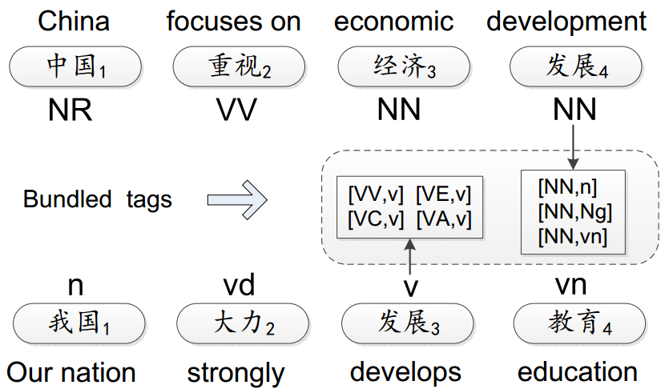
Illustration of bundled tags
Notes:
This is the big picture
Belongs to semi-supervised parsing
The idea is to get more high-quality labeled data for Chinese from bilingual texts by projecting English parse trees into Chinese,
And then combine the manually labeled data with the automatically collected data to train new parsing models,
In order to improve state-of-the-art Chinese dependency parsers.

Slide 12
How to create bundled tags?
Notes:
This is the big picture
Belongs to semi-supervised parsing
The idea is to get more high-quality labeled data for Chinese from bilingual texts by projecting English parse trees into Chinese,
And then combine the manually labeled data with the automatically collected data to train new parsing models,
In order to improve state-of-the-art Chinese dependency parsers.

Slide 13
Mapping functions (Qiu+ 13)
A set of bundled tags that include all possible symmetric mappings between two annotation schemes.
  NN => n vn an v
  NN NR NT <= n
A mapping function defines a search/label space for our model.
Notes:
However, there exist a few obstacles for this research line
First, syntactic non-isomorphism across languages is the most severe and challenging problem, especially when
the source language and the target language belong to different language families, such as English and Chinese.
The second challenge is that even for the same language, there are many different annotation choices to make during treebanking.
One typical example is the noun coordination phrase.
Should the first conjuncting noun or the last noun be the head of the whole phrase
Where should the conjunct word be attached?
Third, if we project a tree of the source-language sentence into the target-language sentence via word alignments, we usually get a partial tree. Then, the problem is how to make use of the target-language sentences with partial trees.
Also, the parsing errors on the source side and the word alignment errors make the bilingual constraints and projected structures contain a lot of noises, and therefore become unreliable

Slide 14
Mapping functions (Qiu+ 13)
Tight mapping function: 145 tags
Automatic mapping function: 346 tags
Relaxed mapping function: 179 tags
Complete mapping function: 1,254 tags (33 × 38)
Notes:
However, there exist a few obstacles for this research line
First, syntactic non-isomorphism across languages is the most severe and challenging problem, especially when
the source language and the target language belong to different language families, such as English and Chinese.
The second challenge is that even for the same language, there are many different annotation choices to make during treebanking.
One typical example is the noun coordination phrase.
Should the first conjuncting noun or the last noun be the head of the whole phrase
Where should the conjunct word be attached?
Third, if we project a tree of the source-language sentence into the target-language sentence via word alignments, we usually get a partial tree. Then, the problem is how to make use of the target-language sentences with partial trees.
Also, the parsing errors on the source side and the word alignment errors make the bilingual constraints and projected structures contain a lot of noises, and therefore become unreliable

Slide 15
CTB5/PD now fall in the same bundled tag space
Notes:
This is the big picture
Belongs to semi-supervised parsing
The idea is to get more high-quality labeled data for Chinese from bilingual texts by projecting English parse trees into Chinese,
And then combine the manually labeled data with the automatically collected data to train new parsing models,
In order to improve state-of-the-art Chinese dependency parsers.

Slide 16
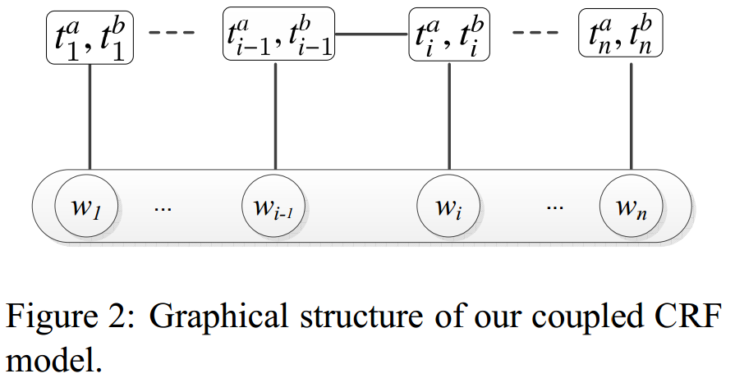
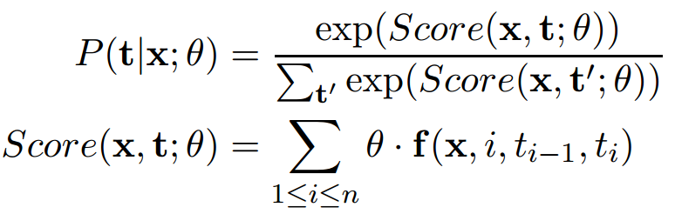
The coupled model in the bundled tag space
Notes:
This is the big picture
Belongs to semi-supervised parsing
The idea is to get more high-quality labeled data for Chinese from bilingual texts by projecting English parse trees into Chinese,
And then combine the manually labeled data with the automatically collected data to train new parsing models,
In order to improve state-of-the-art Chinese dependency parsers.

Slide 17
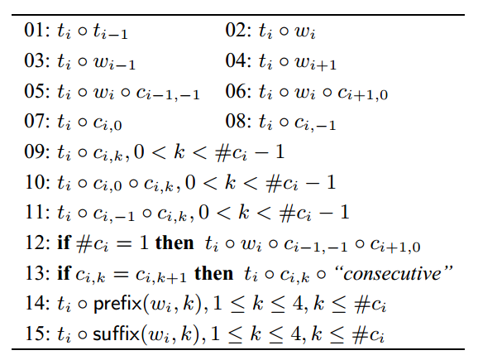
Features in the coupled model
Notes:
This is the big picture
Belongs to semi-supervised parsing
The idea is to get more high-quality labeled data for Chinese from bilingual texts by projecting English parse trees into Chinese,
And then combine the manually labeled data with the automatically collected data to train new parsing models,
In order to improve state-of-the-art Chinese dependency parsers.

Slide 18
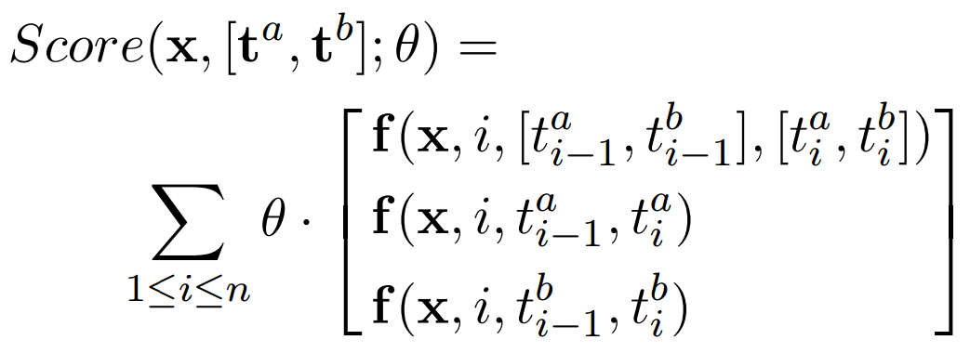
Features in the coupled model
Joint features
Separate features
Notes:
This is the big picture
Belongs to semi-supervised parsing
The idea is to get more high-quality labeled data for Chinese from bilingual texts by projecting English parse trees into Chinese,
And then combine the manually labeled data with the automatically collected data to train new parsing models,
In order to improve state-of-the-art Chinese dependency parsers.

Slide 19

Features in the coupled model
外交部₁ Foreign Ministry | 发言人₂ Spokesman | 答₃ answers
 | NN_n
 | NN_n^外交部 NN^外交部 n^外交部
Joint features
Separate features
Notes:
This is the big picture
Belongs to semi-supervised parsing
The idea is to get more high-quality labeled data for Chinese from bilingual texts by projecting English parse trees into Chinese,
And then combine the manually labeled data with the automatically collected data to train new parsing models,
In order to improve state-of-the-art Chinese dependency parsers.

Slide 20
What is the benefit of this model?
Both datasets are directly used for training.
Can use both joint and separate features.
  Joint features capture the implicit correspondences between annotations.
  Separate features function as back-off/base features.
Notes:
This is the big picture
Belongs to semi-supervised parsing
The idea is to get more high-quality labeled data for Chinese from bilingual texts by projecting English parse trees into Chinese,
And then combine the manually labeled data with the automatically collected data to train new parsing models,
In order to improve state-of-the-art Chinese dependency parsers.

Slide 21
How to train the model?
Notes:
This is the big picture
Belongs to semi-supervised parsing
The idea is to get more high-quality labeled data for Chinese from bilingual texts by projecting English parse trees into Chinese,
And then combine the manually labeled data with the automatically collected data to train new parsing models,
In order to improve state-of-the-art Chinese dependency parsers.

Slide 22
Ambiguous labeling (partial annotation, natural annotation)
Relaxed/weak supervision
  Multilingual transfer on dependency parsing (Tackstrom+ 13)
  Semi-supervised dependency parsing (Li+ 14a, 14b)
  Word segmentation (Jiang+ 13; Liu+14; Yang and Vozila 14)
Notes:
This is the big picture
Belongs to semi-supervised parsing
The idea is to get more high-quality labeled data for Chinese from bilingual texts by projecting English parse trees into Chinese,
And then combine the manually labeled data with the automatically collected data to train new parsing models,
In order to improve state-of-the-art Chinese dependency parsers.

Slide 23
Ambiguous labeling (a PD sentence)
外交部₁ Foreign Ministry | 发言人₂ spokesman | 答₃ answers | 记者₄ reporters’ | 问₅ questions
nt | n | v | n | vn
外交部₁ Foreign Ministry | 发言人₂ Spokesman | 答₃ answers | 记者₄ reporters’ | 问₅ questions
nt_NT nt_NN nt_NR nt_AD … | n_NN n_NT n_NR … | v_VV v_VC v_VE v_AD … | n_NN n_NT n_NR … | vn_NN vn_NR vn_VV …
Notes:
This is the big picture
Belongs to semi-supervised parsing
The idea is to get more high-quality labeled data for Chinese from bilingual texts by projecting English parse trees into Chinese,
And then combine the manually labeled data with the automatically collected data to train new parsing models,
In order to improve state-of-the-art Chinese dependency parsers.

Slide 24
Train with ambiguous labeling
Maximize the likelihood of the data
Maximize the probability of a set of paths
Maximize the sum probability of all paths in the set
Can be solved with the forward-backward algorithm

Slide 25
How to merge two training datasets?
CTB
中国/NR
PD
中国/n
A unified model: Tagger (CTB & PD)
Notes:
This is the big picture
Belongs to semi-supervised parsing
The idea is to get more high-quality labeled data for Chinese from bilingual texts by projecting English parse trees into Chinese,
And then combine the manually labeled data with the automatically collected data to train new parsing models,
In order to improve state-of-the-art Chinese dependency parsers.

Slide 26
SGD training
For each iteration
CTB
中国/NR
PD
中国/n
Random sampling:
N sentences
Random sampling:
M sentences
Training data (N+M) for the current iteration (shuffled)
Notes:
This is the big picture
Belongs to semi-supervised parsing
The idea is to get more high-quality labeled data for Chinese from bilingual texts by projecting English parse trees into Chinese,
And then combine the manually labeled data with the automatically collected data to train new parsing models,
In order to improve state-of-the-art Chinese dependency parsers.

Slide 27
Previous work (Qiu+ 13)
We are directly inspired by their work.
Differences from our work
  Linear model with perceptron-like training
  Only explore separate features
  Approximate decoding
  Rely on manually designed mapping functions
Notes:
This is the big picture
Belongs to semi-supervised parsing
The idea is to get more high-quality labeled data for Chinese from bilingual texts by projecting English parse trees into Chinese,
And then combine the manually labeled data with the automatically collected data to train new parsing models,
In order to improve state-of-the-art Chinese dependency parsers.

Slide 28
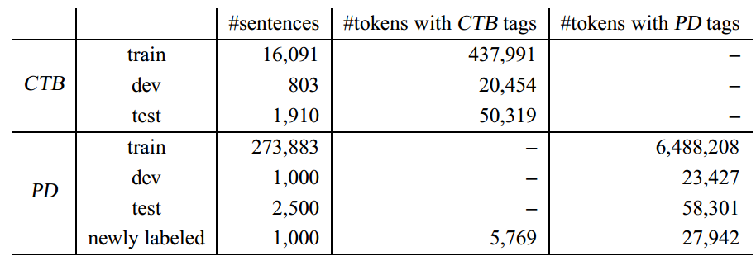
Experiments
Data statistics
Newly annotated data for conversion evaluation
(partial annotation: 20% most difficult tokens)

Slide 29
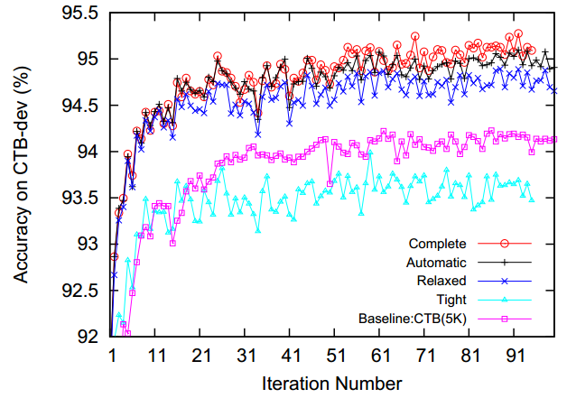
Effect of mapping functions
The coupled CRF can learn the mapping, without linguistic inputs/constraints.
Notes:
Here multilingual DP means tries to improve target-language dependency parsing by making use of bilingual constraints or
Source-language resources or parsers.
There are a few motivations behind this research line.
First, a difficult syntactic ambiguity in one language, …
For example, PP attachment problem is very challenging in English;
however, in Chinese, it is quite easy to attach a Preposition phrase to the correct position.
Second, a more …
For example, English dep parsers can achieve 90% on UAS, whereas Chinese parsers can only achieve 80%.
Such accuracy gap may be due to the intrinsic difficulty of languages or scale of available labeled data.
Therefore, it is reasonable to suppose that the English parser can help Chinese parser on bilingual text.
Third, when the target language has no labeled training data, it is a natural and interesting idea to transfer labeled resources in source language in order to build the target-language parser.
Intrinsic complexity of languages (Chinese vs. English)
Scale of labeled resources
More slides
Give a few examples
For example, English <-> Chinese PP attachment, PP boundary for Chinese
Chinese DE structure, attribute clause

Slide 30
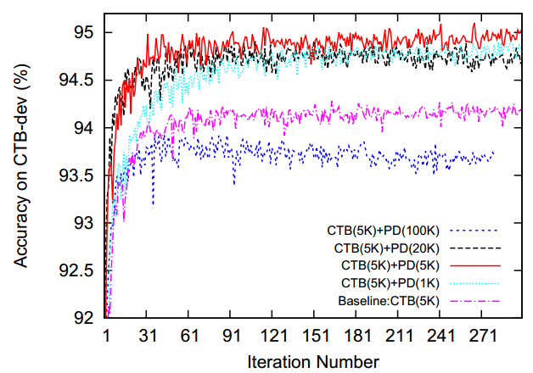
Effect of weighting CTB and PD
Decide a balance in merging two training data
Notes:
This figure shows the effect of using different filtering threshold
the number in parenthesis, we can ignore the second parameter 1.0
and we also show the projection ratio.
When 0.0, means no filtering, which is also called DCA, the ratio is the highest, but performance is very bad
0.1 0.5
We adopt 0.1
Projection ratio means the proportion of words that get head words after projection.

Slide 31
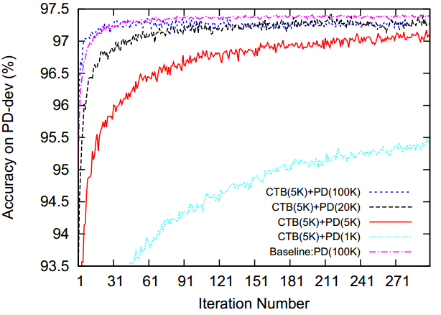
Effect of weighting CTB and PD
Decide a balance in merging two training data
Notes:
This figure shows the effect of using different filtering threshold
the number in parenthesis, we can ignore the second parameter 1.0
and we also show the projection ratio.
When 0.0, means no filtering, which is also called DCA, the ratio is the highest, but performance is very bad
0.1 0.5
We adopt 0.1
Projection ratio means the proportion of words that get head words after projection.

Slide 32
Final results on CTB5-test
+0.9
+0.5
Slightly yet significant better than baselines

Slide 33
Feature study
+0.9
+0.3
-1.2
All features contributes.

Slide 34
Conversion Accuracy (PD => CTB)
+3.3
+2.6
Significantly better than baselines.

Slide 35
Using Converted PD
+0.9
+0.7
Slight accuracy decrease; much more efficient.

Slide 36
Conclusions
We propose a coupled CRF model for utilizing multiple heterogeneous labeled data.
  Can effectively learn the implicit mappings between annotations, without the need of a manually designed mapping function.
  Effective on both one-side POS tagging and POS conversion/transfer tasks.
We have partially annotated 1,000 sentences for POS tag conversion evaluation.

Slide 37
Future directions
  Annotate more data with both CTB and PD tags, and investigate the coupled model with small amount of such annotation as extra training data.
  Propose a more principled and theoretically sound method to merge multiple training data.
  Efficiency issue
  Word segmentation guidelines also differ, which is ignored in this work

Slide 38
Thanks for your time!
Questions?
Codes, newly annotated data, and other resources are released at
http://hlt.suda.edu.cn/~zhli
for non-commercial usage.

Slide 39
Work going on
Our approach is also effective on the word segmentation task.
Adapt our approach to dependency parsing.

Slide 40
Coupled model used for conversion
Constrained decoding
PD=>CTB conversion
  the search space is constrained by the PD-side tags.

Slide 41
The big picture (conversion)
PD
中国/n
CTB+PD
(bundled tag space)
中国/NR_n
CTB
中国/NR (n)
Tagger (CTB+PD)
Trained with ambiguous labeling
Test sentence:
中国/?_n 加油/?_v
Output:
中国/NR_n 加油/VV_v
Notes:
This is the big picture
Belongs to semi-supervised parsing
The idea is to get more high-quality labeled data for Chinese from bilingual texts by projecting English parse trees into Chinese,
And then combine the manually labeled data with the automatically collected data to train new parsing models,
In order to improve state-of-the-art Chinese dependency parsers.

Slide 42
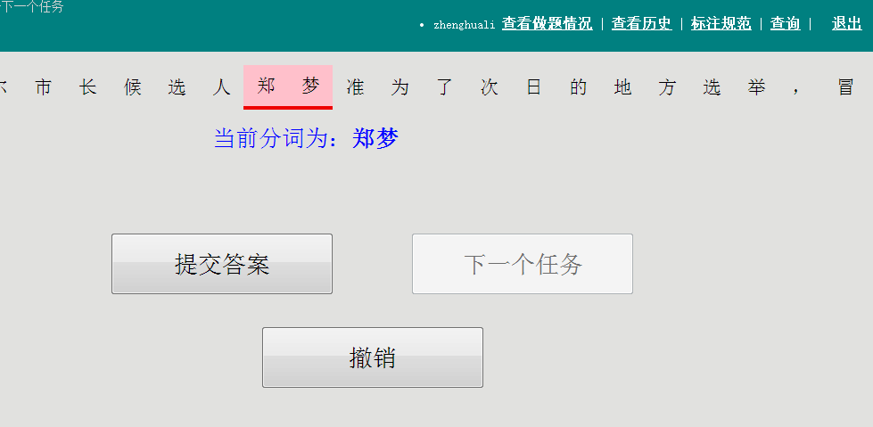
Data annotation

Slide 43
Domain adaptation
Previous studies suggest that directly combining out-domain and in-domain training data does not lead to an optimal model.

